Slide 1
Dialogical Journaling
Writing to Engage to the Text
By Doug Reese
English Teacher/EKU Writing Project Fellow

Slide 2
Objectives
Writing to Engage the Text

Slide 3
Reading Informational Texts
I can locate and cite strong thorough text evidence to support my analysis of an informational text.
CCSI RI-09/10-1
I can analyze in detail how an author develops central themes in their analysis of an event in multiple specific portions of an informative text.
RI-09/10-2
RI-09/10-3
RI-09/10-5

Slide 4
Writing
I can write to draw evidence from informational texts that I read to support my analysis of the text.
W-09/10-9
W-09/10-10
I can write informative/explanatory texts to explore advanced ideas by developing my position through quotations and analysis of those quotations.
W-09/10-2b

Slide 5
Context
Writing to Engage Text

Slide 6
Context
Overview of WWII by guest lecturer
Established student questions about Holocaust
Students received essay question options for unit test
PEE (Point→Evidence→Explain) strategy expectation
Moving toward Triple Decker Paragraphs

Slide 7
Best Practices
Writing to Engage the Text

Slide 8
Student-Centered
“The best starting point for schooling is young people’s questions and interests; all across the curriculum, beginning with students’ own questions should take precedence over the recounting of arbitrarily and distantly selected information. For almost any chunk of required subject matter, we can find “a way in”—a subtopic, puzzle, an angle, an implication—that can activate kids’ intrinsic motivation.

Slide 9
Student-Centered
Authentic: Real, rich complex ideas and materials are at the heart of the curriculum. Lessons or textbooks that water down, control, or oversimplify content ultimately disempower students.

Slide 10
Student-Centered
Holistic: Young people learn best when they encounter whole ideas, events, and materials in purposeful contexts, not by studying subparts isolated from actual use.

Slide 11
Student-Centered
Experiential: Active, hands-on, concrete experience is the most powerful and natural form of learning. Students should be immersed in the most direct experience possible for the content of every subject.

Slide 12
Student-Centered
Challenging: Students learn best when faced with genuine challenges, choices, and responsibility in their own learning. We need to provide ‘content ladders’ that move kids steadily upward in complexity and challenge, as school years and school careers proceed toward college and career readiness.”

Slide 13
Locating Evidence in the Text
They called him Moché the Beadle, as thought he had never had a surname in his life. He was a man of all work at a Hasidic synagogue. The Jews of Sighet—the little town in Transylvania where I spent my childhood—were very fond of him. He was poor and lived humbly. Generally my fellow townspeople, though they would help the poor, were not particularly fond of them. Moché the Beadle was the exception. Nobody ever felt embarrassed by him. Nobody ever felt encumbered by his presence. He was a past master in the art of being insignificant, of seeming invisible.
What makes Moché acceptable to the Jews of Sighet?

Slide 14
Night Reading Journal Entry
Select a passage from today’s reading and copy it in the space below. Remember:
Unless otherwise stated, passage is anything from a clause to a paragraph.
If the passage is long, and you don’t need the middle part to make your point, use bracketed ellipses […] to replace the part you skip
Get the page number so you can guide us to your selection

Slide 15
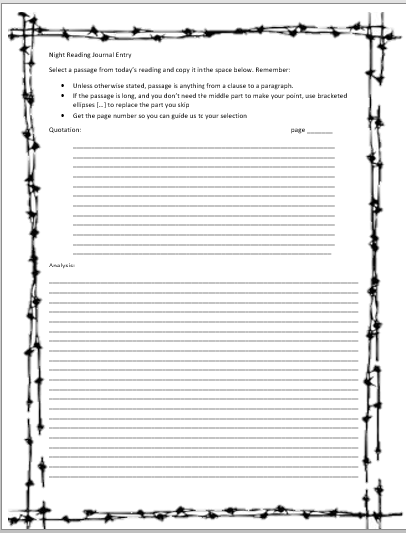
3
“Through the long days and nights, he went from one Jewish house to another, telling the story of Malka, the young girl who had taken three days to die, and of Tobias, the tailor, who had begged to be killed before his sons…
Moché had changed. There was no longer any joy in his eyes. He no longer sang. He no longer talked to me of God of the cabbala, but only of what he had seen. People refused not only to believe his stories, but even to listen to him.”
Moché is no longer the unobtrusive man of God, but has now become a symbol of the reality of the Jews’ situation, a situation they believe will go away if they refuse to recognize it. As such, if they listen to him, they will have to acknowledge the danger of their situation.

Slide 17
Don’t Forget to PEE!
Point
Evidence
Explain
What point are you trying to make?
“Claim”
Substantiate your Claim with Evidence!
How does the Evidence Support the Claim?

Slide 19
References
Wiesel, E. (2006). Night. Hill and Wang: New York.
Zemelman, Daniels,Hyde. (2012). Best Practice. 4th ed. Heinemann: Portsmouth, NH.

